Slide 1
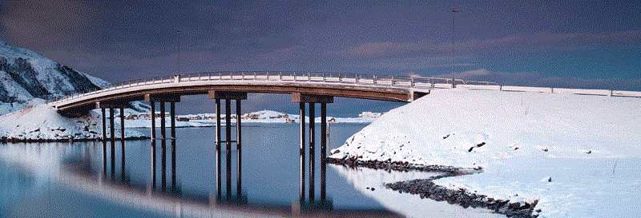
‘The High North’
A Geographical-Political Concept, with Emphasis on Marine Resources Management
Odd Gunnar Skagestad
Deputy Director General
Bergen, 28 January 2013

Slide 2
Sustainable Development
Two Aspects - Twin Concepts:
Environment Conservation
Resource Management
Management policies:
Sustainable Use – based on:
Best available Scientific Advice
Ecosystem Approach

Slide 3
International Cooperation
Legal Instruments and Cooperation Agreements:
Bilateral
Regional
Global
Globally: Broad Framework Agreements:
1982 UN Law of the Sea Convention
1995 UN Fish Stocks Agreement

Slide 4
‘The High North’
The ‘Official’ English Synonym for ‘Nordområdene’
A uniquely Norwegian Concept
A Political Concept:
No Precise Geographical Definition
Elastic & Dynamic

Slide 5
From 2002 -
The Epoch of the ‘New High North Policy’:
Increased Public Attention
Ownership
A Surge of High North-related Activities
A Series of Policy Documents

Slide 7
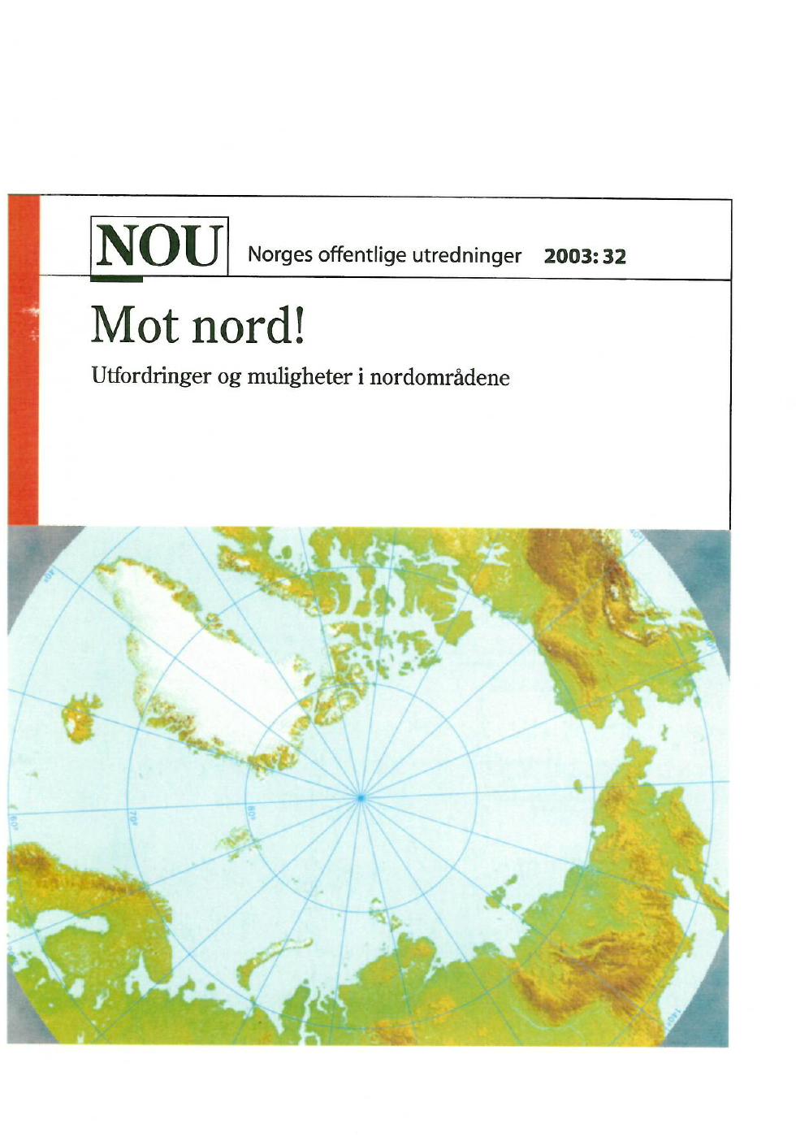

Slide 8
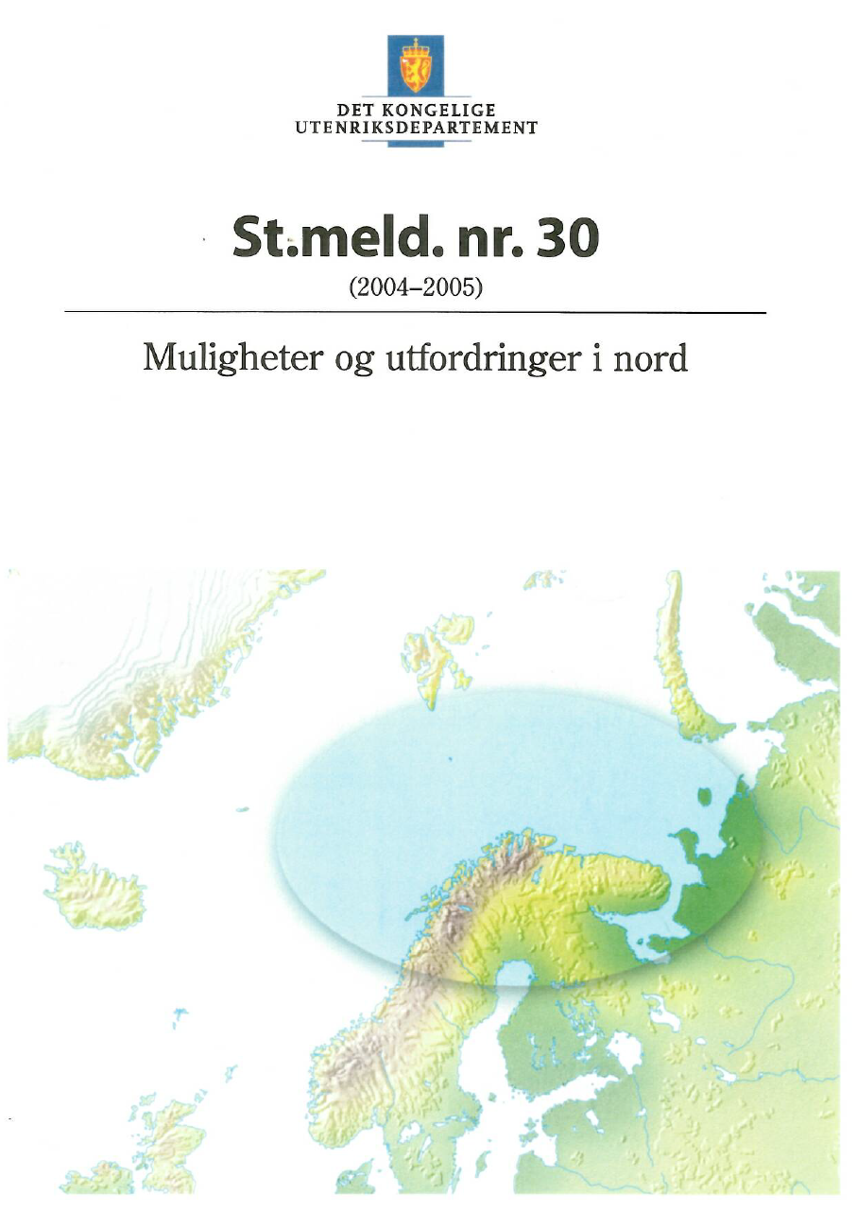

Slide 11
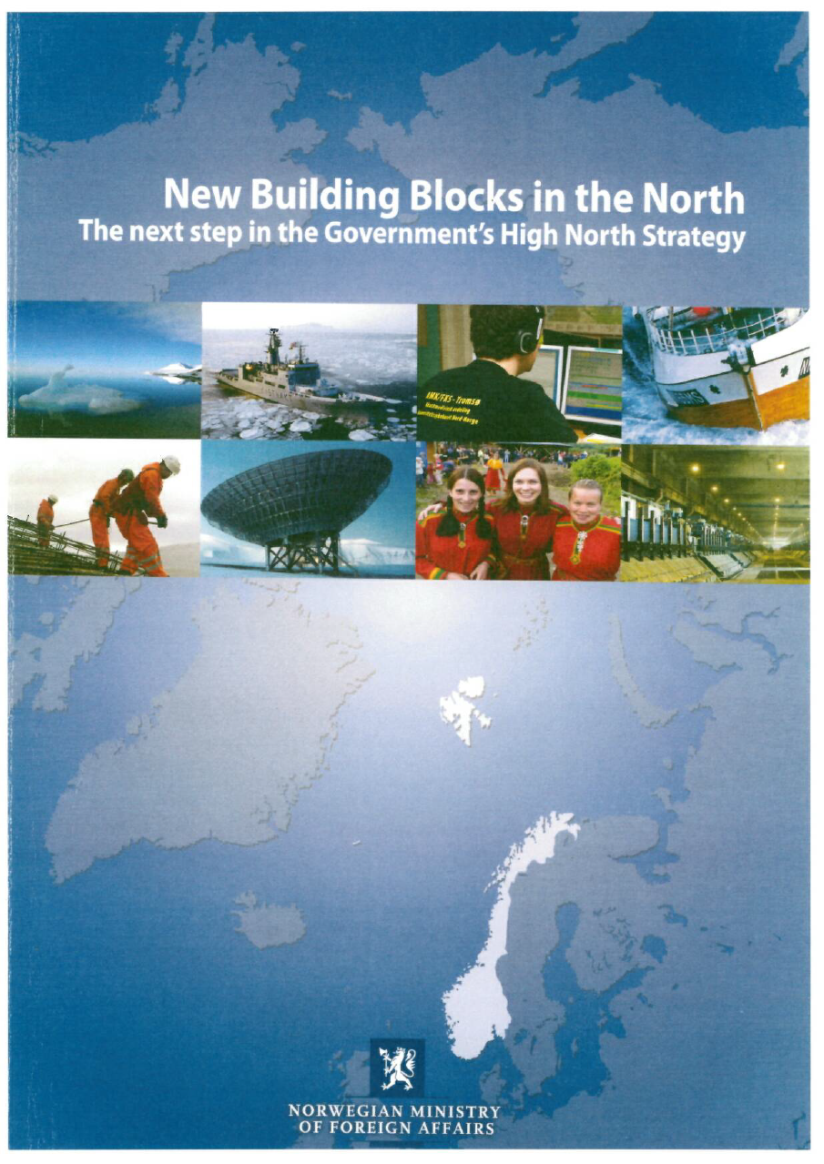

Slide 12
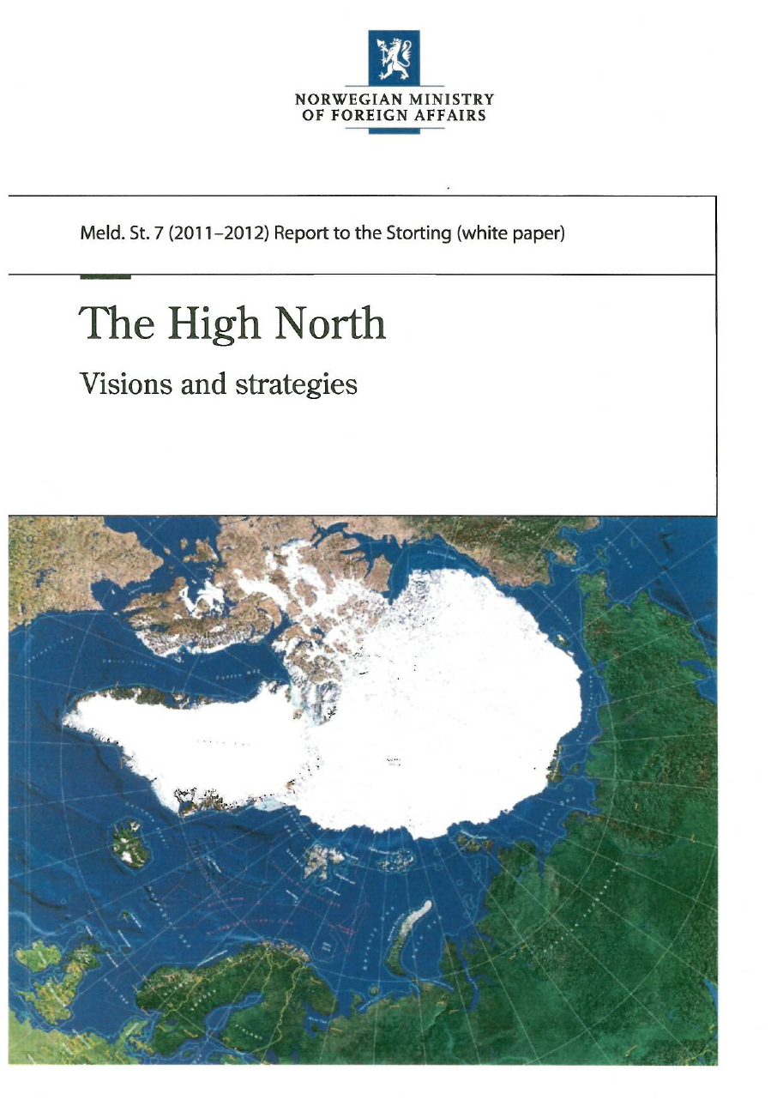

Slide 13
White Paper (2011-2012) The High North Visions and Strategies
‘’The High North is Norway’s most important strategic foreign policy priority’’
3 ‘Key Policy Objectives’
15 ‘Strategic Priorities’

Slide 14
3 Policy Objectives
To safeguard peace & stability and provide predictability
To ensure an integrated, ecosystem-based management regime that safeguards biodiversity and provides a basis for sustainable use of resources
To strengthen the basis for employment, value creation and welfare throughout the country by means of a regional and national effort in cooperation with partners from other countries and relevant indigenous groups

Slide 15
Se oftere mot nord.
Gå mot vinden, du får rødere kinn.
Finn den ulendte stien. Hold den.
Den er kortere.
Nord er best.
Vinterens flammehimmel,
sommernattens solmirakel.
Gå mot vinden. Klyv berg.
Se mot nord.
Oftere.
Det er langt dette landet.
Det meste er nord.
(Rolf Jacobsen: Nord)

Slide 16
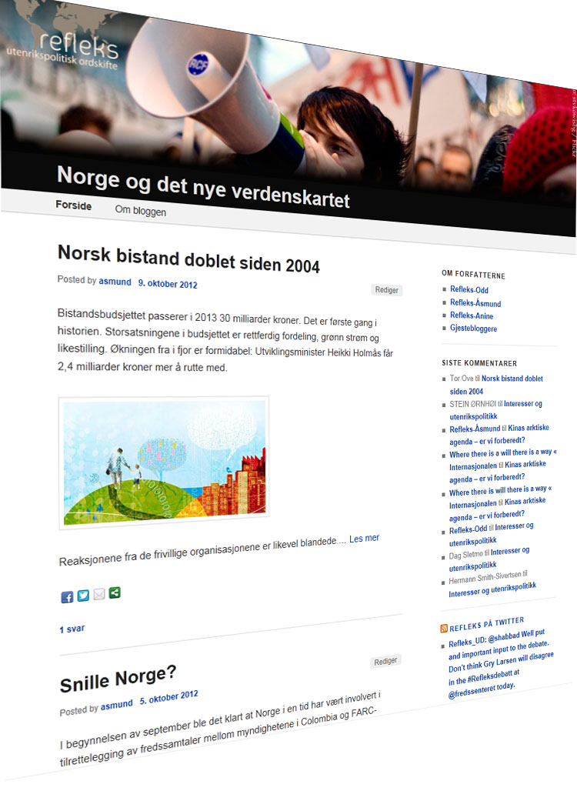
Delta i debatten!
Hvis du er interessert i utenrikspolitikk og har egne meninger – delta i debatten!
Refleks ønsker gjestebloggere og kommentarer velkommen.
http://blogg.regjeringen.no/refleks

